Slide 1






TAXPAL
PROJECT
Presenting : Team 1

Slide 2

01
PROJECT OVERVIEW
Introduction to TaxPal and its mission for freelancers
02
TECH STACK
Technologies and frameworks used in development
CONTENT
03
FEATURE & FUNCTIONALITY
Core capabilities and user experience highlights
OUTCOMES & IMPACT
04
Results achieved and user feedback
TEAM & Q/N
05
Meet the team and interactive session

Slide 3






01
PROJECT OVERVIEW
MISSIONARY
STRENGTH
TARGET
SKILL
To simplify financial management for freelancers and gig workers through automated
Complex tax calculations and poor financial visibility
Freelancers, gig workers, and independent contractors
Automated tax estimation with real-time financial insights

Slide 4

02
TECH STACK
01
MongoDB
02
Express.js
03
React.js
04
Node.js

Slide 5

03
FEATURES & FUNCTIONALITY
Income & Expense
Manual and automated transaction entry
Smart categorization with ML suggestions
Receipt attachment and storage
Budget
Regional tax calculation based on location
Quarterly tax payment reminders
Deduction optimization suggestions

Slide 6

Tax Estimation Engine
Auto-calculates estimated tax based on income and deductions
Real-time updates for tax slab and policy changes
Forecasts annual tax liability with visualization
Transactions
Add, edit, and delete transactions seamlessly
View categorized expense and income summaries
Export transaction history in multiple formats

Slide 7

Report
Generate detailed monthly and yearly reports
Interactive charts and analytics dashboard
Downloadable PDF/Excel summary
Settings Profile & Category
Secure profile creation and authentication
Customizable preferences

Slide 8


USER REGISTRATION
USER REGISTRATION & ACCESS CONTROL
Allows new users to sign up securely with verified email authentication.
SECURITY FEATURES
JWT token authentication, encrypted password storage, and secure session management

Slide 9


KEY CHALLENGES
TaxPal faces challenges in maintaining data accuracy, enhancing user experience, and optimizing system performance.

Slide 10



DATA ACCURACY
PERFORMANCE OPTIMIZATION
Maintaining precise tax and transaction calculations for error-free reports.
Handling large transaction volumes efficiently without system lag.
UX DESIGN
Designing a clean, intuitive interface for easy navigation and trust.

Slide 11
CHALLENGES & SOLUTIONS
CHALLENGE
SOLUTION
Tax estimation errors
Slow report generation
Confusing UX
Performance issues
Data security risks
Profile management
Real-time calculations
Automated reports
Simplified interface
Backend optimization
Secure authentication
Easy-to-update profile settings

Slide 12



TAX ESTIMATION ACCURACY
Implemented formula-based calculators with real-time tax rule updates.
HOW CHALLENGES WERE ADDRESSED
TRANSACTION MANAGEMENT
Built a dashboard to track, filter, and categorize all tax payments.
USER EXPERIENCE (UX)
Simplified UI with step-by-step workflows and tooltips.
PERFORMANCE & SPEED
Optimized backend using caching, asynchronous processing, and efficient database queries.

Slide 13
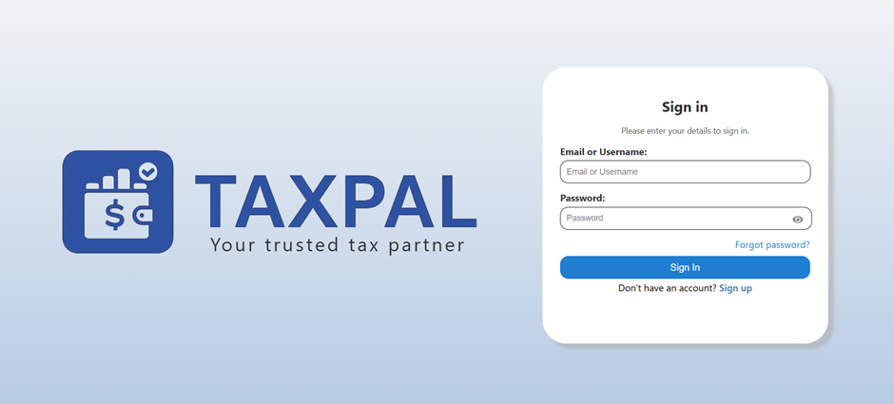
USER INTERFACE MOCKUPS
Showcase screenshots of key UI components:
01
01
Sign In
02

Slide 14
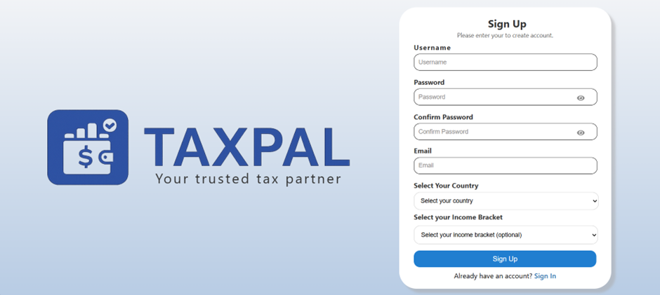
USER INTERFACE MOCKUPS
Showcase screenshots of key UI components:
02
01
Sign Up
02

Slide 15
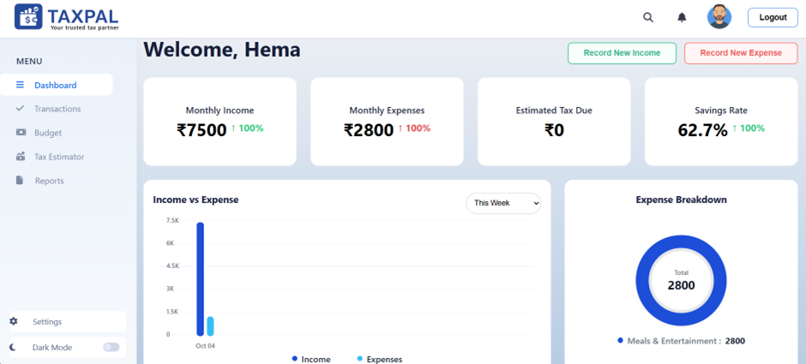
USER INTERFACE MOCKUPS
Showcase screenshots of key UI components:
03
01
DashBoard
02

Slide 16
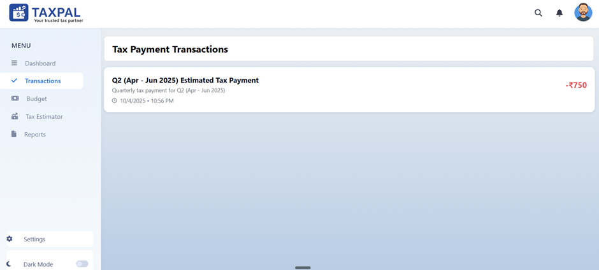
USER INTERFACE MOCKUPS
Showcase screenshots of key UI components:
04
01
Transaction
02

Slide 17
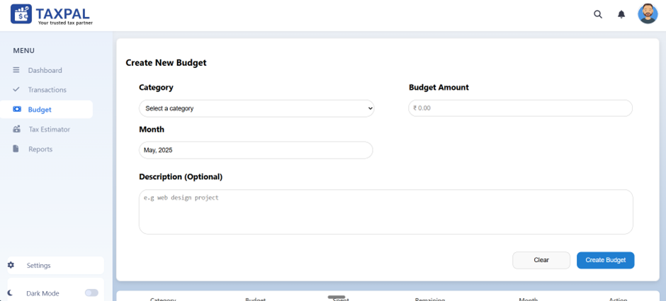
USER INTERFACE MOCKUPS
Showcase screenshots of key UI components:
05
01
Budgeting
02

Slide 18
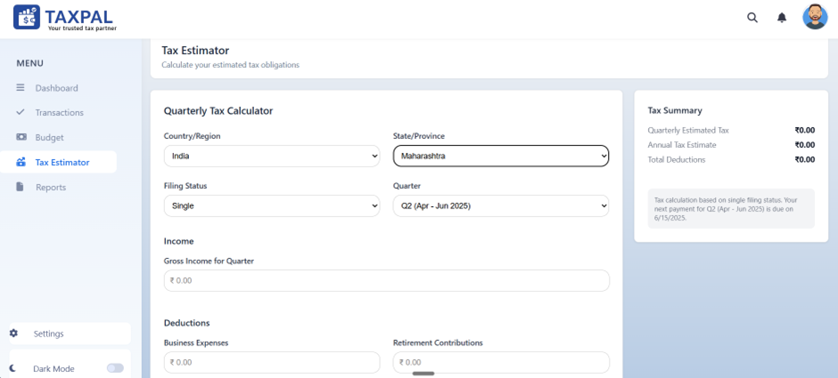
USER INTERFACE MOCKUPS
Showcase screenshots of key UI components:
06
01
Tax Estimator
02

Slide 19
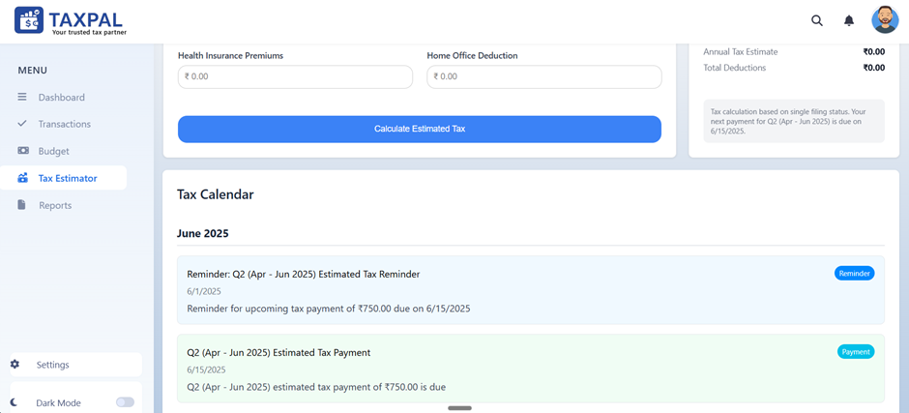
USER INTERFACE MOCKUPS
Showcase screenshots of key UI components:
07
01
Tax Calender
02

Slide 20
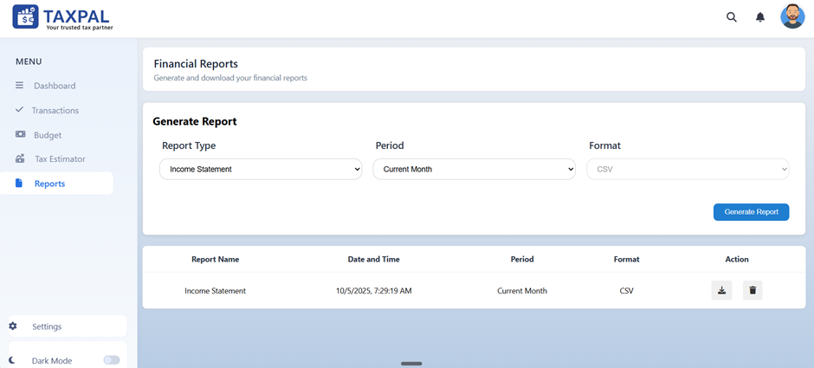
USER INTERFACE MOCKUPS
Showcase screenshots of key UI components:
08
01
Reports
02

Slide 21


OUTCOMES & IMPACTS
An overview of the benefits and tangible changes brought about by TaxPal implementation

Slide 22





04
OUTCOMES
500+
Beta Users
95%
Accuracy Rate
75%
Time Saved
92%
User Satisfaction

Slide 23

USER MANAGEMENT
Streamlined experience with time savings and financial clarity
IMPACTS
TECHNICAL ACHIEVEMENT
Scalable, real-time system supporting multi-regional operations
FUTURE POTENTIAL
Expansion-ready platform with AI integration and global reach

Slide 24


05
OUR TEAM

Slide 25

Q & A

Slide 26

THANK YOU
Presented by: Team 1

